Slide 1

Leverage on-chain data to predict and Trade Crypto
A naive attempt on multi-ML models
Team Member: Zhang Yi, Tang Qiyin, Li Xuan, Cai Xiwen, DAO DUY HUNG, Cai Yuxin

Slide 2
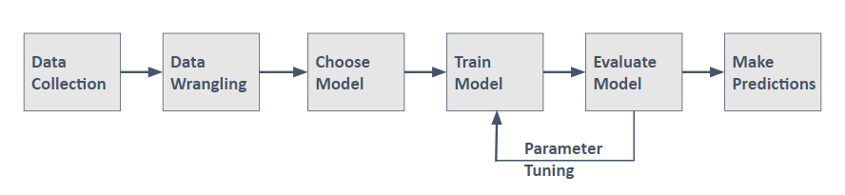
Background
The large-enough crypto market shares similarities with the equity & commodities market but exhibits higher volatility and uniqueness.
By viewing cryptocurrencies as not only a representation of one's stake in a vast ecosystem but also as a versatile currency that can be spent (e.g., for gas fees, DeFi farming) and earned (e.g., through interest or validator rewards) within an expansive digital kingdom, we can utilize fundamental economic principles(supply and demand, distribution etc..) to reasonably forecast monetary and financial policies.
By leveraging the on-chain data analysis, the prediction of digital assets can have more economic sense and more predictable.
The goal of this work is to overcome the limitations of a black-box approach and present an efficient method for selecting the features that influence cryptocurrency prices the most. We propose a framework of feature selection techniques to identify the best features for predicting the future price.
Frameworks for the Machine Learning Process:

Slide 3

TABLE OF CONTENTS
01
02
03
Data & Model Preparation
Model Prediction
- 5 models
Strategy Building
& Backtesting
0‹#›

Slide 4
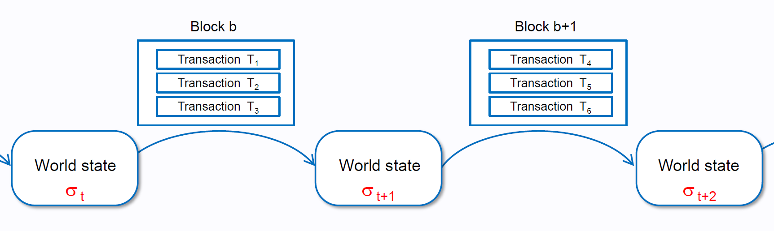
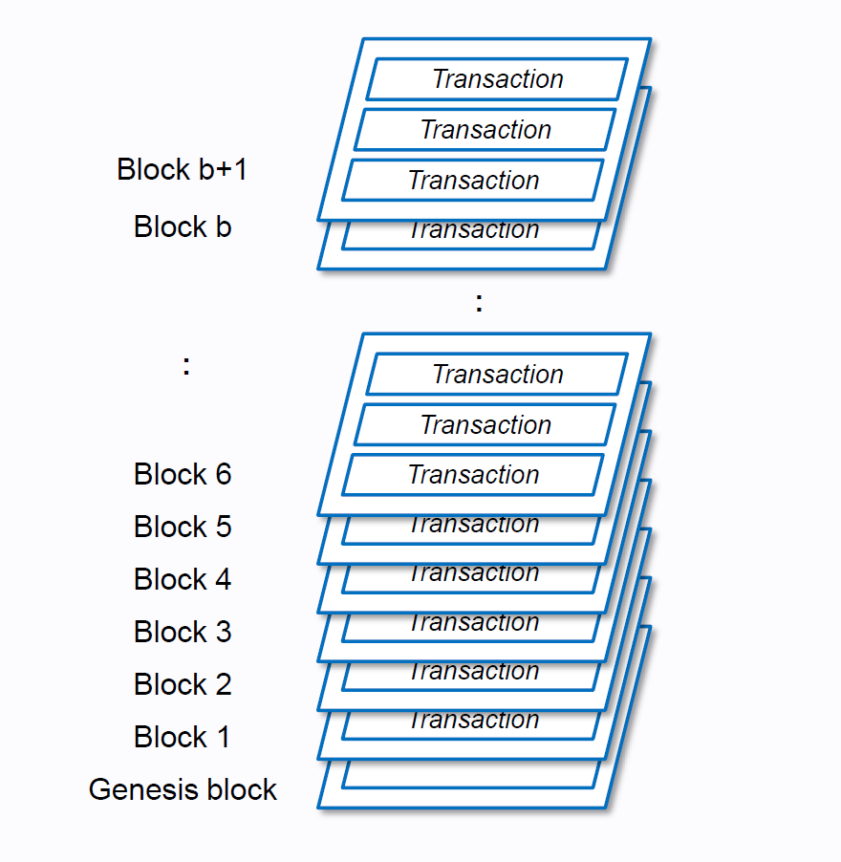
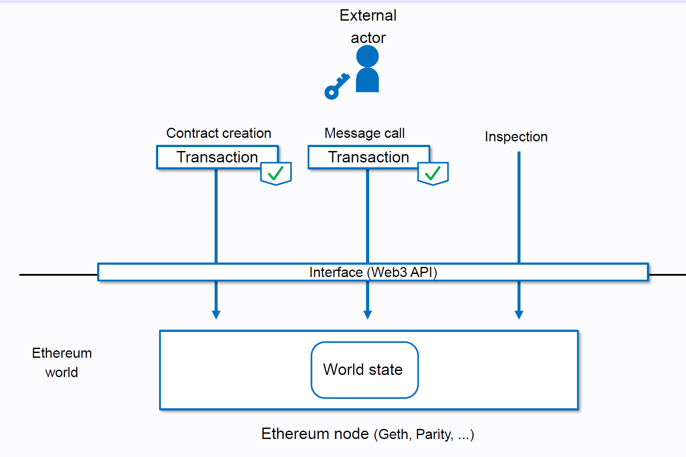
What’s Blockchain? - A Chain of States
What’s Blockchain? - A Chain of States
‹#›

Slide 5
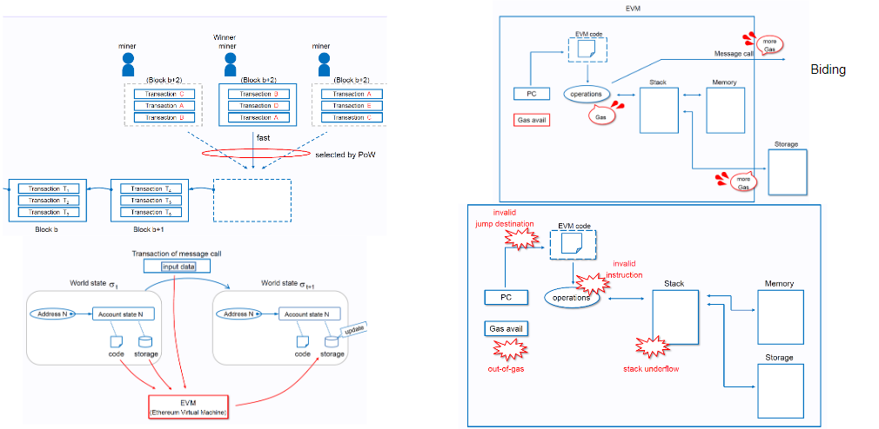
What’s Blockchain? - A Chain of States

Slide 6

01
Data & Model Preparation
(2022)
‹#›

Slide 7
Data Preparation
The fluctuation of ETH & BTC prices is not only related to changes in time, but also related to economic factors, on-chain activities, market sentiment, causing a stochastic price movement. We predicted Ethereum price using – variables from various sources in the period of ---- as following:
Macro Economic Factors (14)
Technical Indicators (19)
On-chain Features &Indicators of BTC&ETH (77&80)
0‹#›

Slide 8
Technical indicators
Macro Economic Factors
10-30-200 days/14-21-49days:
RSI, MACD, SMA, EMA, KDJ, Bolling Bands, MOM
Development Indices (11)
SP500, Dow Jones Average 30 (DOW30),Euro Stoxx 50, NASDAQ225, Crude Oil (Brent), Shanghai Stock Exchange(SSE), Gold, Volatility Index of S&P 500 (VIX), Nikkei 225, Financial Times Stock Exchange 10, US Dollar Index (DXY).
Global Currency Ratio (6)
GBP/USD, JPY/USD, CHF/USD, CNY/USD, EUR/USD, DXY
On-chain Features for BTC&ETH
Addresses, Blocks, Defi, Distribution, ETH2, Fee Structure, Generative Indicators, Supply, Protocol, Transactions

Slide 9
On-chain Data Description
Active Addresses
The number of unique addresses that were active either as a sender or receiver. Only addresses that were active in successful transactions are counted.
Total Value Locked in DeFi (TVL)
The total value locked in all of DeFi. Please note that this does not only include DeFi in the Ethereum network.
Block interval
The mean time (in seconds) between mined blocks.
Block size
The mean size of all blocks created within the time period (in bytes).
Supply of Top 1% Addresses
The percentage of supply held by the top 1% addresses. For Bitcoin we use entities rather than addresses. Exchange addresses/entities, smart contract addresses, and other special asset-specific addresses are excluded
Exchange Balance(%)
The percent supply held on exchange addresses.
Note that exchange metrics are based on our labeled data of exchange addresses that we constantly keep updating
Exchange Netflow Volume
The difference in volume flowing into exchanges and out of exchanges, i.e. the net flow of coins into/out of exchanges

Slide 10
Data Description
ASOL
ASOL is the average age (in days) of spent transaction outputs. Outputs with a lifespan of less than 1h are discarded.
SOPR
The Spent Output Profit Ratio (SOPR) is computed by dividing the realized value (in USD) divided by the value at creation (USD) of a spent output.
Fee Ratio Multiple
FRM is defined as the ratio between the total miner revenue and transaction fees. FRM is a measure of a blockchain's security and gives an assessment how secure a chain is once block rewards disappear.
Gas
The median gas price paid per transaction.
Liveliness
The difference in volume flowing into exchanges and out of exchanges, i.e. the net flow of coins into/out of exchanges
Fee Ratio Multiple
FRM is defined as the ratio between the total miner revenue and transaction fees. FRM is a measure of a blockchain's security and gives an assessment how secure a chain is once block rewards disappear.
Net Unrealized P/L
Net Unrealized Profit/Loss is the difference between Relative Unrealized Profit

Slide 11
Data Description
Short Term Holder
NUPL
STH-NUPL is Net Unrealized Profit/Loss that takes into account only UTXOs younger than 155 days and serves as an indicator to assess the behaviour of short term investors.
Network Value to Transactions(NVT)
The Network Value to Transactions (NVT) Ratio is computed by dividing the market cap by the transferred on-chain volume measured in USD.
MVRV_Z_Score
The MVRV Z-Score evaluates whether Bitcoin is overvalued or undervalued relative to its ‘fair value’. When the market value, measured as network valuation by spot price multiplied by supply, is significantly higher than the realized value, represented by the cumulative capital inflow into the asset, it has typically signaled a market top (red zone).
NVT Signal
NVTS is a modified version of the original NVT Ratio. It uses a 90 day moving average of the daily transaction volume in the denominator instead of the raw daily transaction volume.
Inflation Rate
The yearly inflation rate, i.e. the percentage of new coins issued, divided by the current supply (annualized)

Slide 12
Data Description
Velocity
Velocity is a measure of how quickly units are circulating in the network and is calculated by dividing the on-chain transaction volume (in USD) by the market cap, i.e. the inverse of the NVT ratio.
Realized Volatility
Realized volatility is the
standard deviation of returns from the mean return of a market. It is measured on log returns over a fixed time horizon or over a rolling window to obtain a time-dependent observable.
Difficulty
The current estimated number of hashes required to mine a block. Note: Bitcoin difficulty is often denoted as the relative difficulty with respect to the genesis block, which required approximately 2^32 hashes.
Criculating Supply
The total amount of all coins ever created/issued, i.e. the circulating supply
Contract Calls
The total number of smart contract calls on the Ethereum network initiated by Externally Owned Addresses (EOAs), i.e. external transactions. Only successful transactions are counted.
Hash Rate
The average estimated number of hashes per second produced by the miners in the network.
Transaction
The total amount of transactions. Only successful transactions are counted.

Slide 13
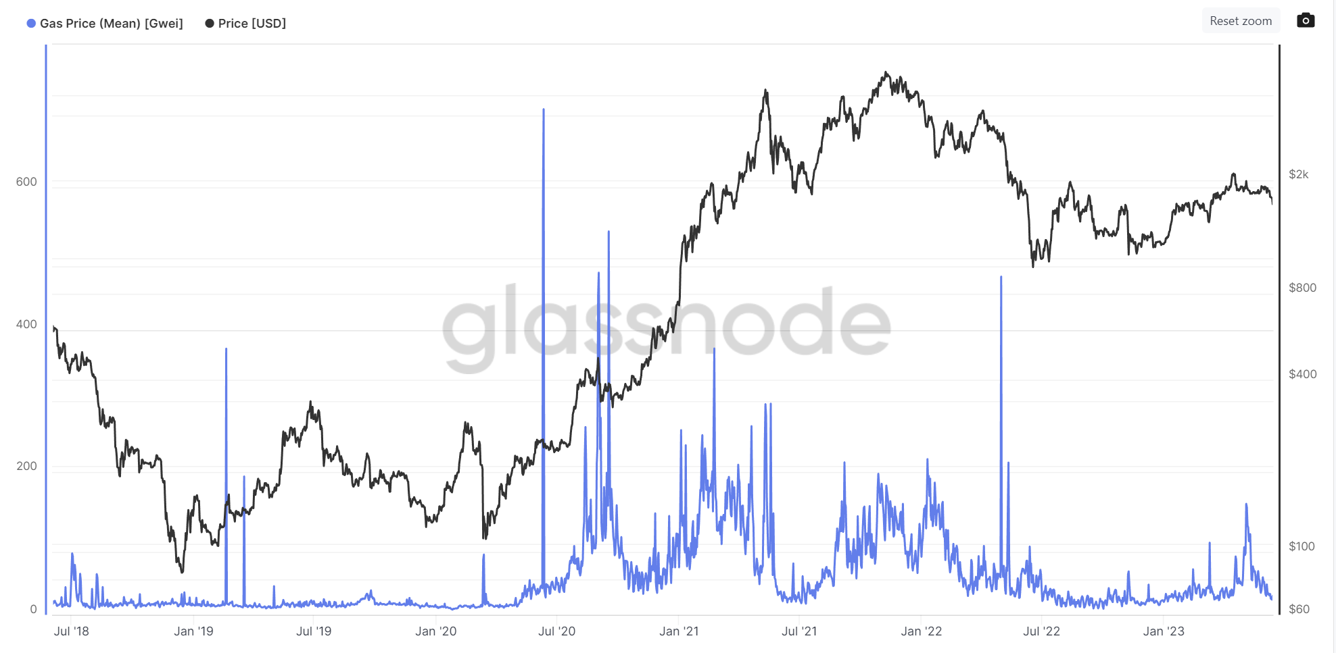
Why on-chain indicators matter?(1)
Gas: the fee required to successfully conduct a transaction or execute a contract on the Ethereum blockchain platform.
Gas is used to pay validators for the resources needed to conduct transactions.(in an auction manner)
When will the gas go crazy?
- Economic activities
- To be specific, trading on Defi apps is lucrative.
Notes:
Supply demand

Slide 14
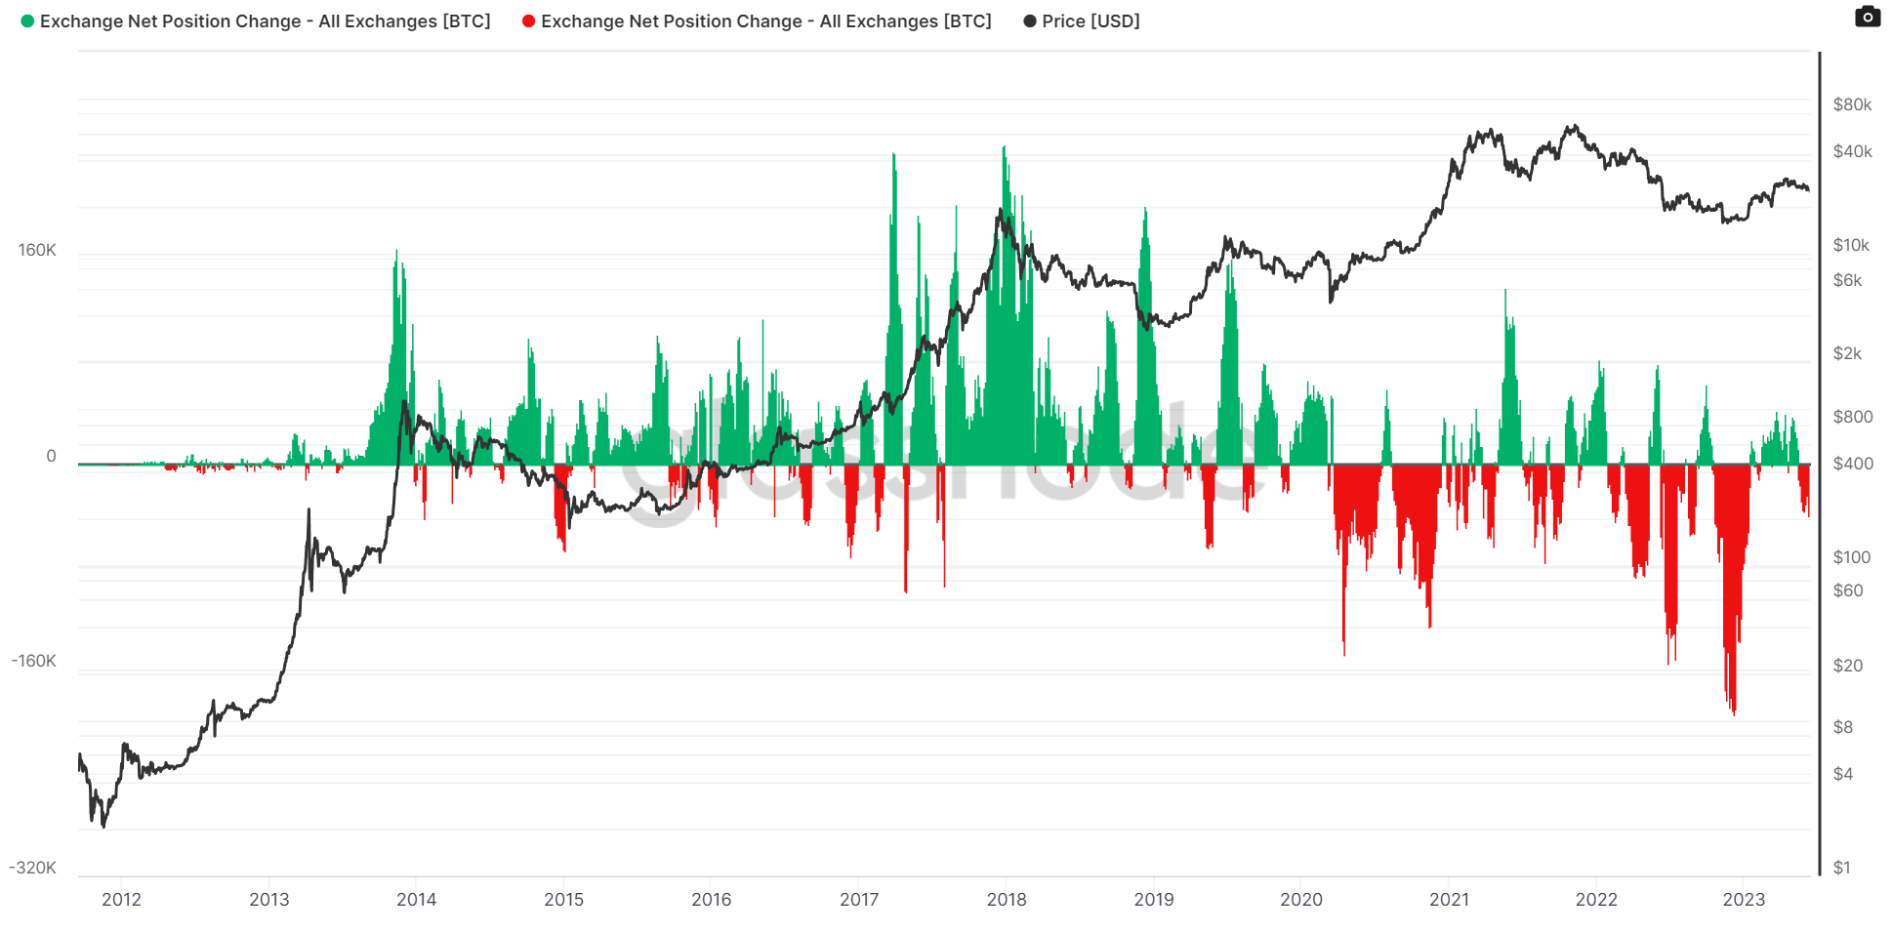
Why on-chain indicators matter?(2)
Net Balance of Exchanges’ Wallet:
The 30d(yoy) change of the supply held in exchange wallets.
Why deposit your coins into Centralized exchanges?
1. Better Liquidity
2. More advanced trading functions
3. You want to swap it into other coins!
Why withdraw them to your on-chain wallets?
1. Fundamentalist: Not your coin not your money(FTX)
2. Chips are cheap enough, you finished your buying and start to wait
Notes:
People doing what? Counter-party, exchanges are also mm

Slide 15
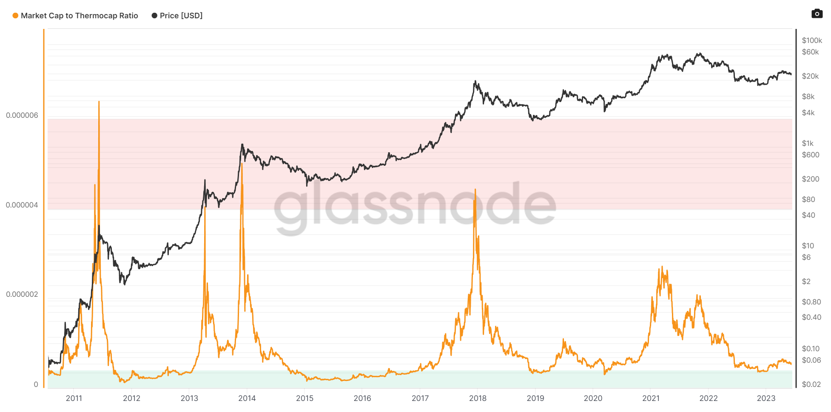
Why on-chain indicators matter?(3)
MTR: Market cap / Thermocap, and can be used to assess if the asset's price is currently trading at a premium with respect to total security spend by miners.
The ratio is adjusted to account for the increasing circulating supply over time.
1. Lag and smooth again
2. Can then create iterative features
- Miners relative difficulties?
- Counterparty?
Notes:
MTR: counterparty

Slide 16
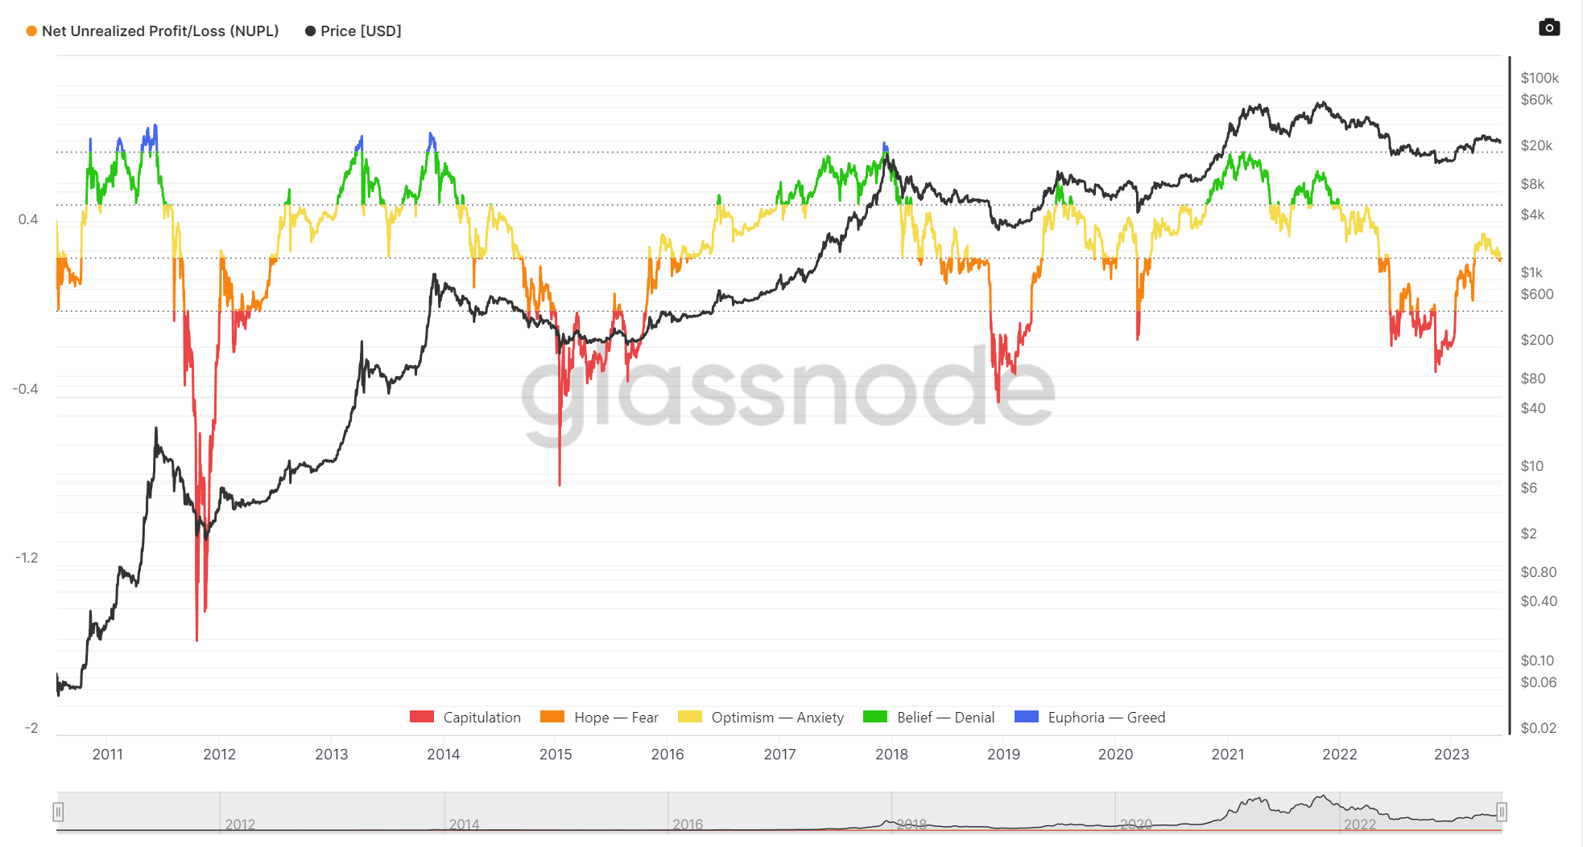
Why on-chain indicators matter?(4)
NUPL: The profit (loss) of a bitcoin is calculated by taking the difference between the current price and the price at the time the bitcoin last moved.
It causes sorts of dataleak (have price info)
1. Lag and smooth to avoid data leakage
2. Can then create iterative features?
- Long-term/Short-term Holder?
- Entities segmentation?
Notes:
Counterparty: everyone is underwater or above water

Slide 17
EDA
Wrangling parts are emitted since it’s too long, data from yfinance,Glassnode, The Graph and Nansen mostly.

Slide 18
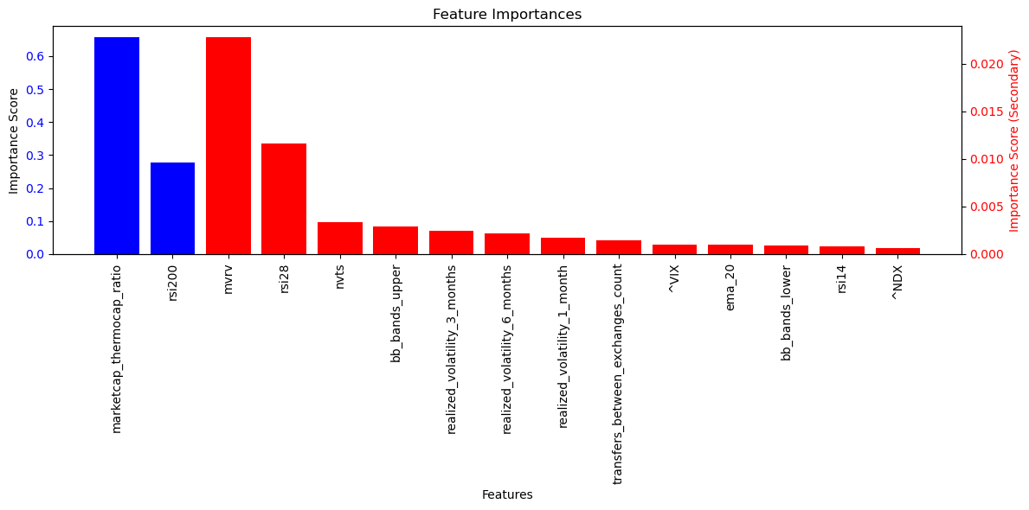
Feature Importances and Selection-BTC
Make Both X and Y as percentage change, then run through randomforestregressor() and gradientboostingregressor()
Select top 49
Start from 50th the importance score drop from e-03 to e-05

Slide 19
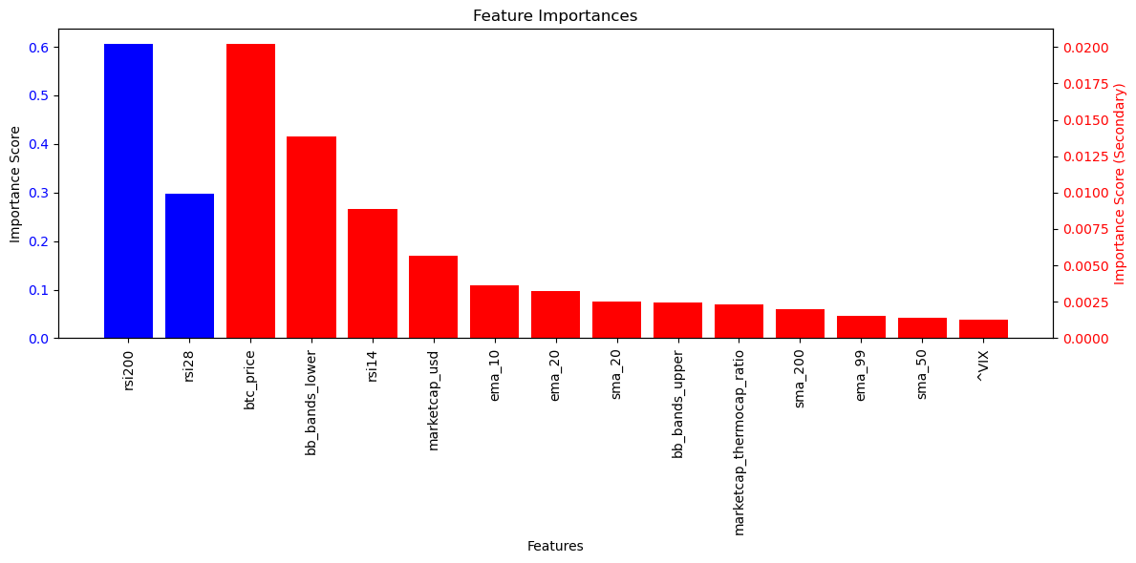
Feature Importances and Selection-ETH
Make Both X and Y as percentage change, then run through randomforestregressor() and gradientboostingregressor()
Select top 95
Start from 96th the importance score drop from e-03 to e-05
Fundamental features perform better than BTC’s

Slide 20
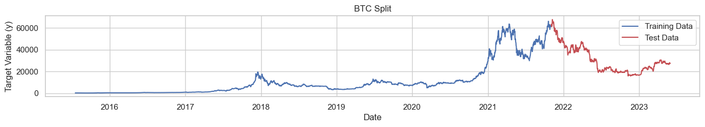
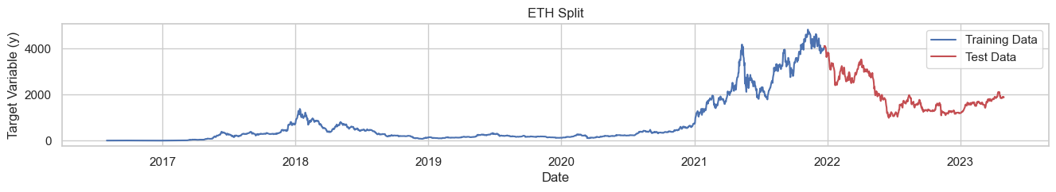
Split!
BTC from 2015-08 to 2023-05, testing start = 2021-11
ETH from 2016-01 to 2023-05, testing start = 2021-08
Testing Set 20%
Training Set 80%

Slide 21
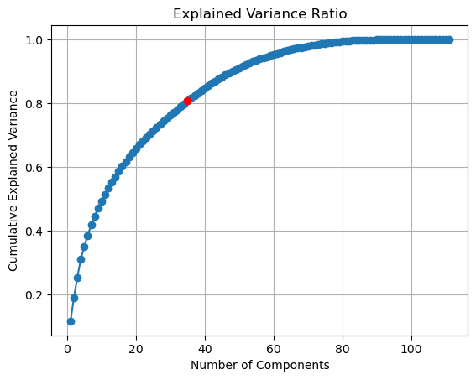
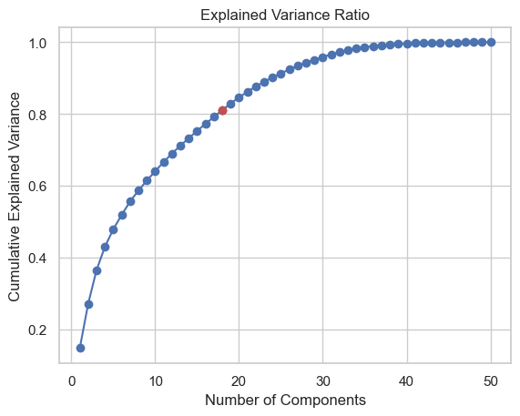
PCA’ed(ETH/BTC)
ETH: 28(AT 80%EV)
BTC: 17(AT 80%EV)

Slide 22
02
Model Prediction
- 6 Models

Slide 23
6 shortlist Models
Linear Regression
Random Forest
SVM
Gradient Boosting
LSTM
GRU
Time-series CV
Bayesian/Grid Search Hyperparameter Tuning
Directions
Some can handle both numerical and categorical features, capture non-linear relationships
Have ability to handle a large group of high-dimensional features
Time-series RNNs

Slide 24
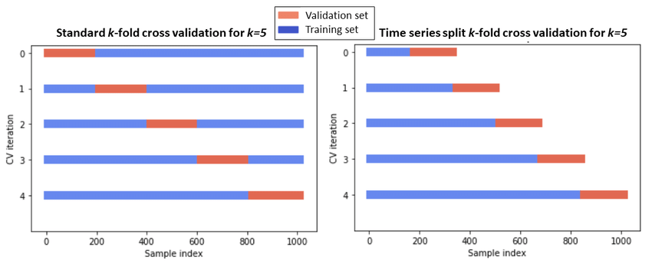
Time-series Cross-Validation
Cross-validation on a rolling basis. Start with a small subset of data for training purpose, forecast for the later data points and then checking the accuracy for the forecasted data points. Rolling_window = 10

Slide 25
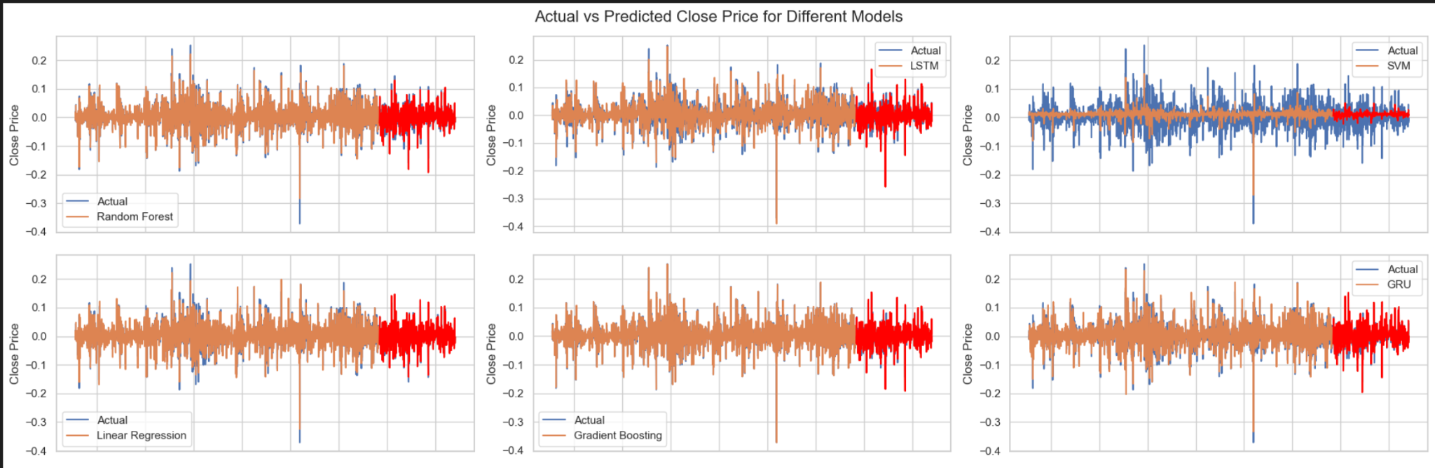
Bitcoin Regressor Prediction

Slide 26
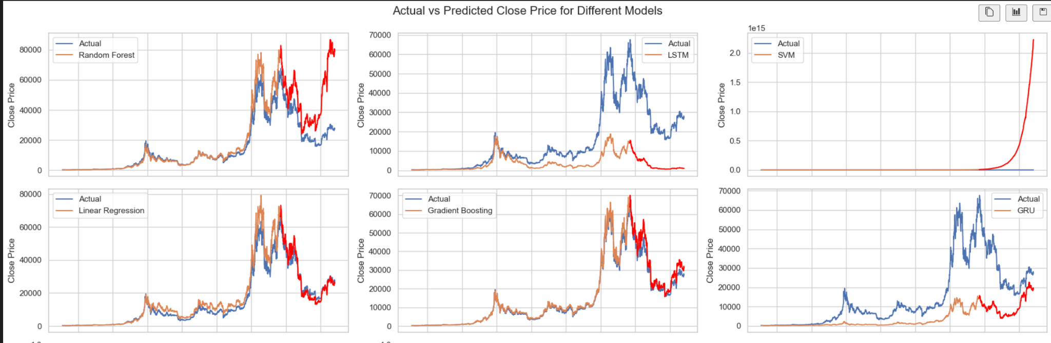
Bitcoin Regressor Prediction

Slide 27
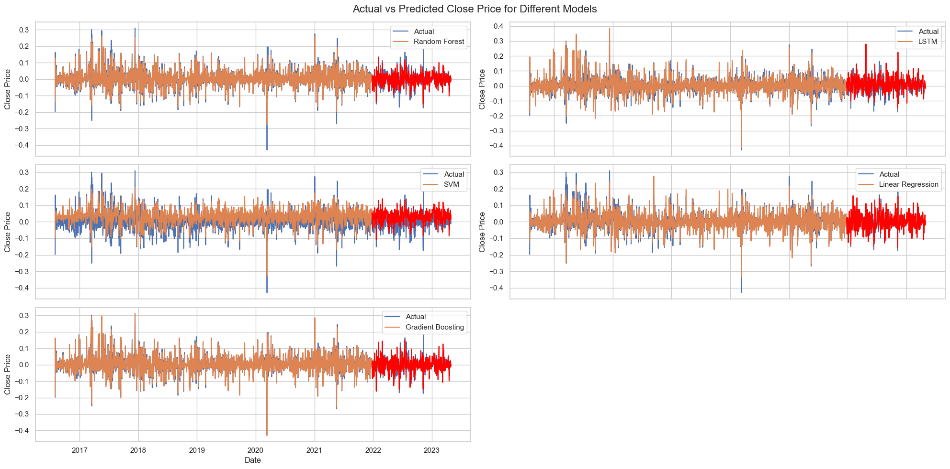
Ethereum Regressor Prediction

Slide 28
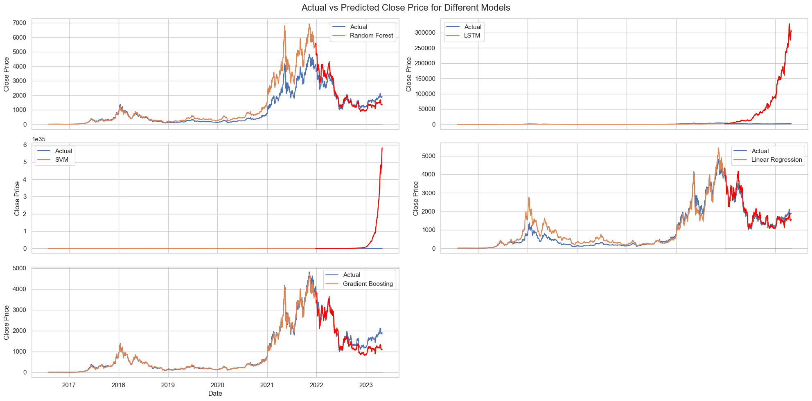
Ethereum Regressor Prediction

Slide 29
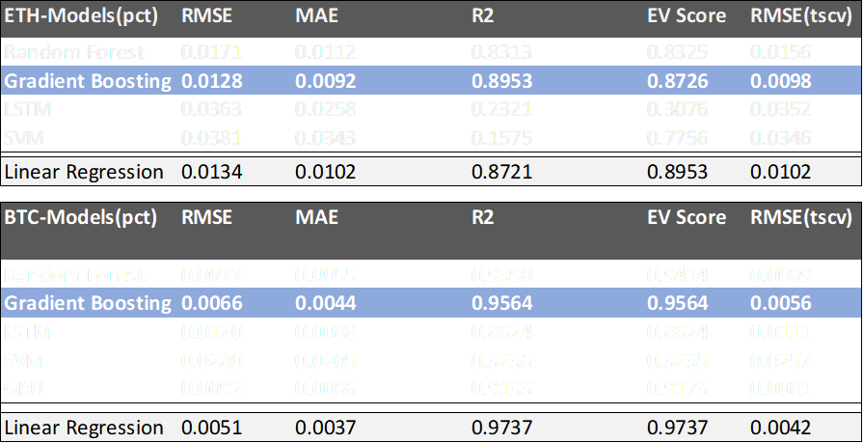
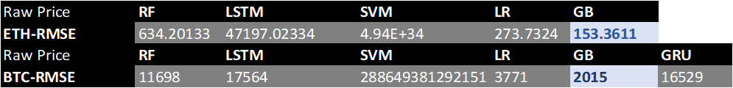
Summary – model evaluation

Slide 30
03
Strategy Building & Backtesting

Slide 31
Trading Strategy
Trend-following strategy: Analyze the direction of the predicted percentage change (positive or negative) and use it to determine the trend. If the predicted change suggests an upward trend, consider buying or holding the asset. Conversely, if the predicted change suggests a downward trend, consider selling or avoiding the asset.

Slide 32
Trading Signals
Position setting
On day t:
If signal[t] = 1,
And if we have no open position
Long with 1x leverage
And if we have an open short position
Close the short position
Calculate returns
And if we have an long position already
Just hold the long
If signal[t] = -1,
And if we have no open position
Short with 1x leverage
And if we have an open long position
Close the long position
Calculate returns
And if we have an short position already
Just hold the short
It’s worth noting that if I closed my position at day t, then only on day t+1 I could open an opposite position. No dual-move in one trading day.
If predicted pct_change of day t is positive,
Signal = 1
Otherwise, signal = -1
No pct_change predicted is 0

Slide 33
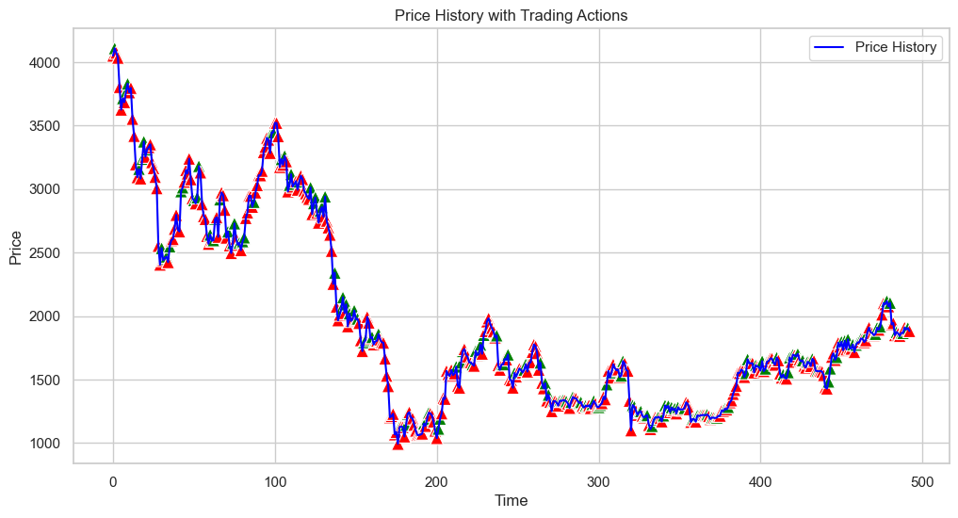
Backtesting Result- ETH
Winning Rate: 95.12%
Return: 10468.72x(XD)
Max Drawdown:0.89%
Sharpe Ratio: N.A.

Slide 34
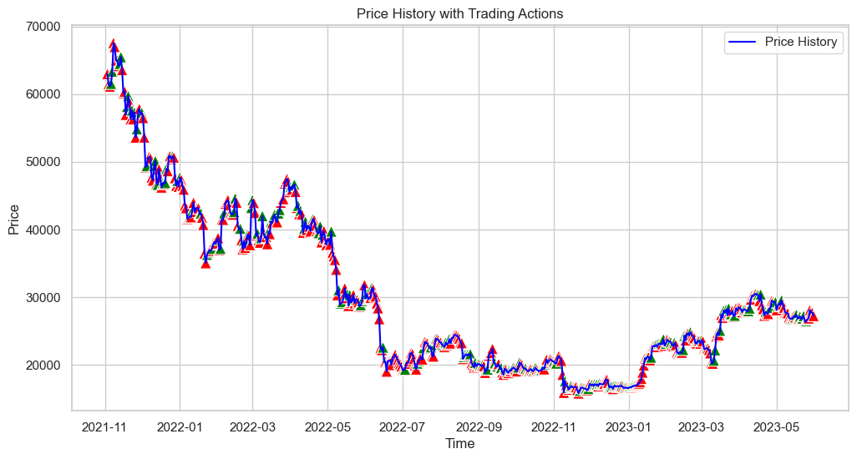
Backtesting Result- BTC
Winning Rate: 96.43%
Return: 47279.52x(XD)
Max Drawdown:0.62%
Sharpe Ratio: N.A.

Slide 35
Some reflections
When making predictions, we used the complete data of the current day to predict today's price. However, in a real trading environment, we do not have access to the complete data of day t when making trades at time t.
There is data leakage of price information in the features used for machine learning.
Transaction costs and market microstructure were not taken into account.
Setting the entry price equal to the previous day's closing price is overly optimistic and rarely occurs in reality.
Features set also needs to be optimized.

Slide 36
A Better Approach?
Threshold-based strategy: Set a threshold for the predicted percentage change. If the predicted change exceeds the threshold, consider it a signal to take a specific action, such as buying or selling. You can experiment with different threshold values and observe the performance of your strategy.
Combination strategy: Combine multiple prediction models or indicators to generate a more robust trading strategy. For example, you can use an ensemble of models and consider a trading signal only if a majority of models agree on the predicted direction.

Slide 37
Trading Signals
Position setting
Set up threshold first!
On day t(Catch the market overreaction)
If 2 out of 3 models(RF,GB,LR) agreed that the spread between predicted pct_change and backtest_actual_pct surpasses an absolute value, then initiate a trading signal at day t+1(we suppose it’s over-pumped or over-dumped)
If the spread crosses the threshold,at day t-1
If both pred are positive,
If predicted() > actual, generate signal = 1,
If predicted() < actual, generate signal = -1
If the spread back within the threshold,
If previous signal = 1, generate signal =-1
If previous signal = -1, generate signal = 1
Otherwise signal = 0
On day t:
If signal[t] = 1,
And if we have no open position
Long with 1x leverage
And if we have an open short position
Close the short position
Calculate returns
And if we have an long position already
Just hold the long
If signal[t] = -1,
And if we have no open position
Short with 1x leverage
And if we have an open long position
Close the long position
Calculate returns
And if we have an short position already
Just hold the short

Slide 38
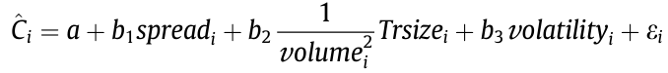
Dive deeper…
In statistical terms, the spread is left-skewed. XG boost still outperformed.
Set threshold in a ladder manner, 4 ladders according to distribution(40/50/60/70th percentile of 4yr data)
Generally, for each ladder, allocate capital equally.
If the spread move to higher ladder, open more same-directional positions.
If the spread once cross multi-ladders, open positions gradually day by day.
If the spread drop to lower ladder, close the position one by one according to the current status.
To avoid extreme market conditions and “fake” price movements, introduce certain indicators that relate volume and price. These indicators help generate signals and determine position sizing.
Example: Price dump hard(once -30%) + volume shrink as 0.5x of the SMA90 daily volume(04 Dec, 2021, China Ban crypto)
If triggered at day t, spread ↑, we consider market is more overreacting, then deploy more capital at day t+1.
Example: Price dump hard + volume skyrocket as 3.4x of the SMA90 daily volume(08 Nov, 2022)
If triggered at day t, spread ↑, we consider market is more event-based moving, then run ASAP.
Act as a proxy of event-based signals
Set trading fees as Binance VIP1, 0.02% Maker fee 0.04% Taker fee. Set 0.03% as an average.
Nomura model for trading costs:
Trading orderbook data from Binance(thanks Alan)
Optimize features set and models. (XGBoost again, remove ~80% of the features, keep core indicators)

Slide 39
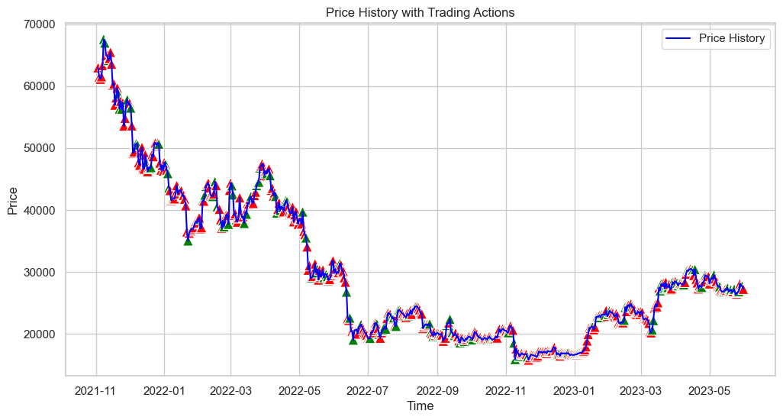
Backtesting Result- BTC
Without ladders:
Winning Rate: 46.84%
Return: 56.65%
Max Drawdown:-37.68%
Sharpe Ratio: 0.853
With ladders&VPT and optimized model:
Winning Rate: 62.79%
Return: 187.52%
Max Drawdown: -14.12%
Sharpe Ratio: 2.424

Slide 40
Q&A

Slide 41
Thanks!
With heart

Slide 42
Reference
Fama, E. F. and French, K. R. Testing Trade-Off and Pecking Order Predictions About Dividends and Debt[J], The Review of Financial Studies, 2002, 15(1): 1-33. -PDF-, pp. 21
Hausman, Jerry A, Bronwyn H Hall, and Zvi Griliches. 1984. Econometric Models for Count Data with an Application to the Patents-R&D Relationship. Econometrica 52 (4): 909–938. -PDF-, pp. 912
Sebastião, H., Godinho, P. Forecasting and trading cryptocurrencies with machine learning under changing market conditions. Financ Innov 7, 3 (2021). https://doi.org/10.1186/s40854-020-00217-x
Kristoufek L (2015) What are the main drivers of the bitcoin price? Evidence from wavelet coherence analysis. PLoS ONE 10(4):e0123923
Huang JZ, Huang W, Ni J (2019) Predicting Bitcoin returns using high-dimensional technical indicators. J Finance Data Sci 5(3):140–155
Aharon DY, Qadan M (2019) Bitcoin and the day-of-the-week effect. Finance Res Lett 31:415–424
Alessandretti L, ElBahrawy A, Aiello LM, Baronchelli A (2019) Anticipating cryptocurrency prices using machine learning. Complexity 2018:8983590

